Slide 1
Budgiecoin
SD6501 – Mobile Application Development
Michael du toit

Slide 2
Budgiecoin
Why?
Personal Finance is an important, but often overlooked aspect of people’s lives. BudgieCoin aims to help users become more financially aware.
How?
Personal Finance Application
Log your Income and Expenses
Show your Account balances

Slide 3
Core Functionalities
Register and Login
Create, Update and Delete Accounts
Create, Update and Delete Transactions
View all recorded Transactions and all Accounts
Update and Delete your User Account

Slide 4

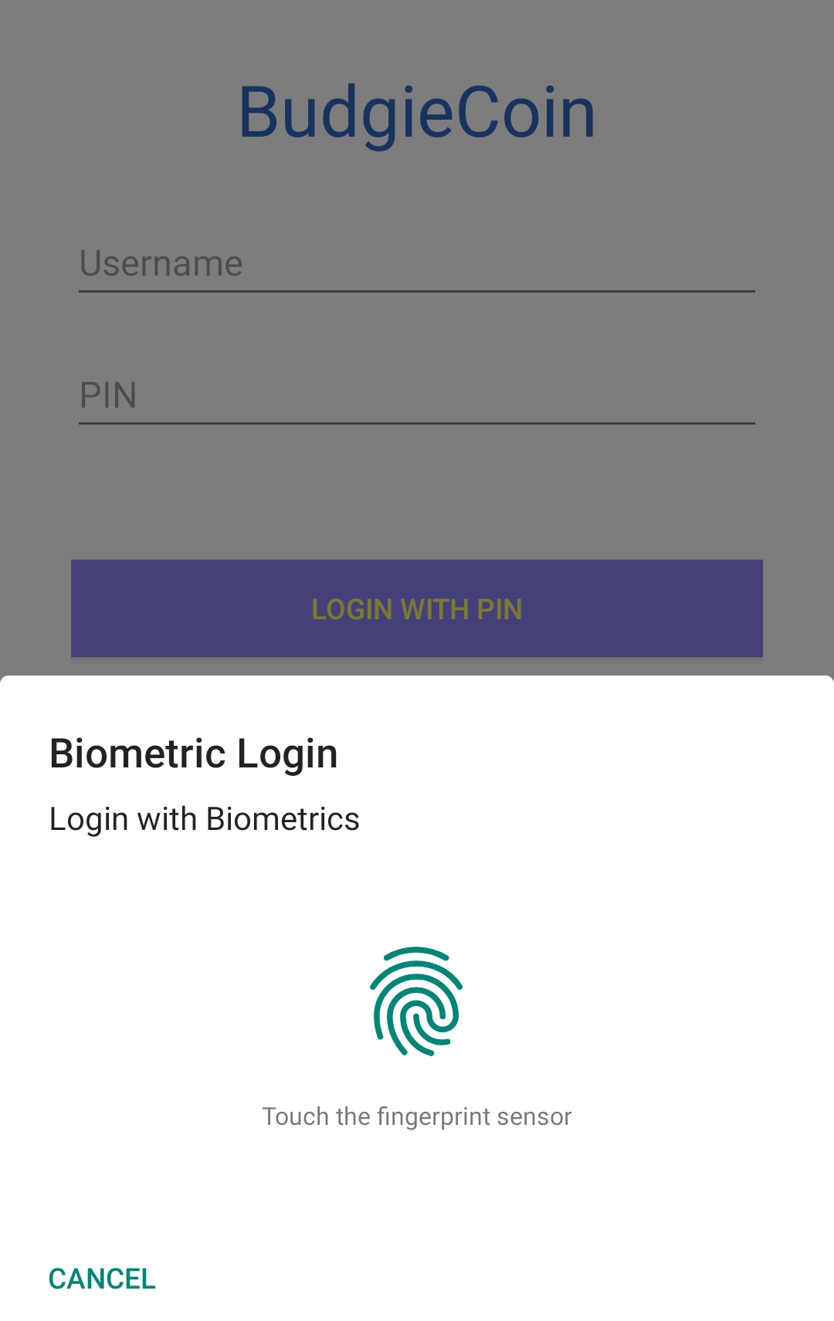
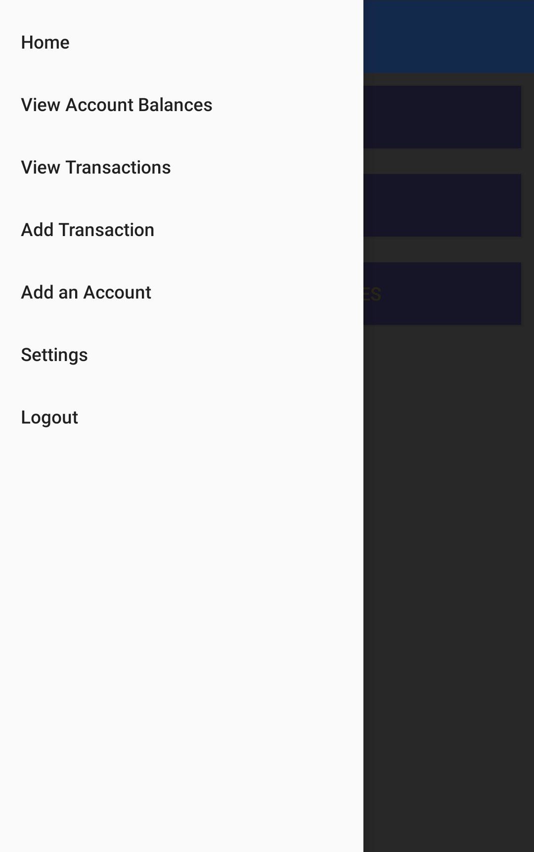
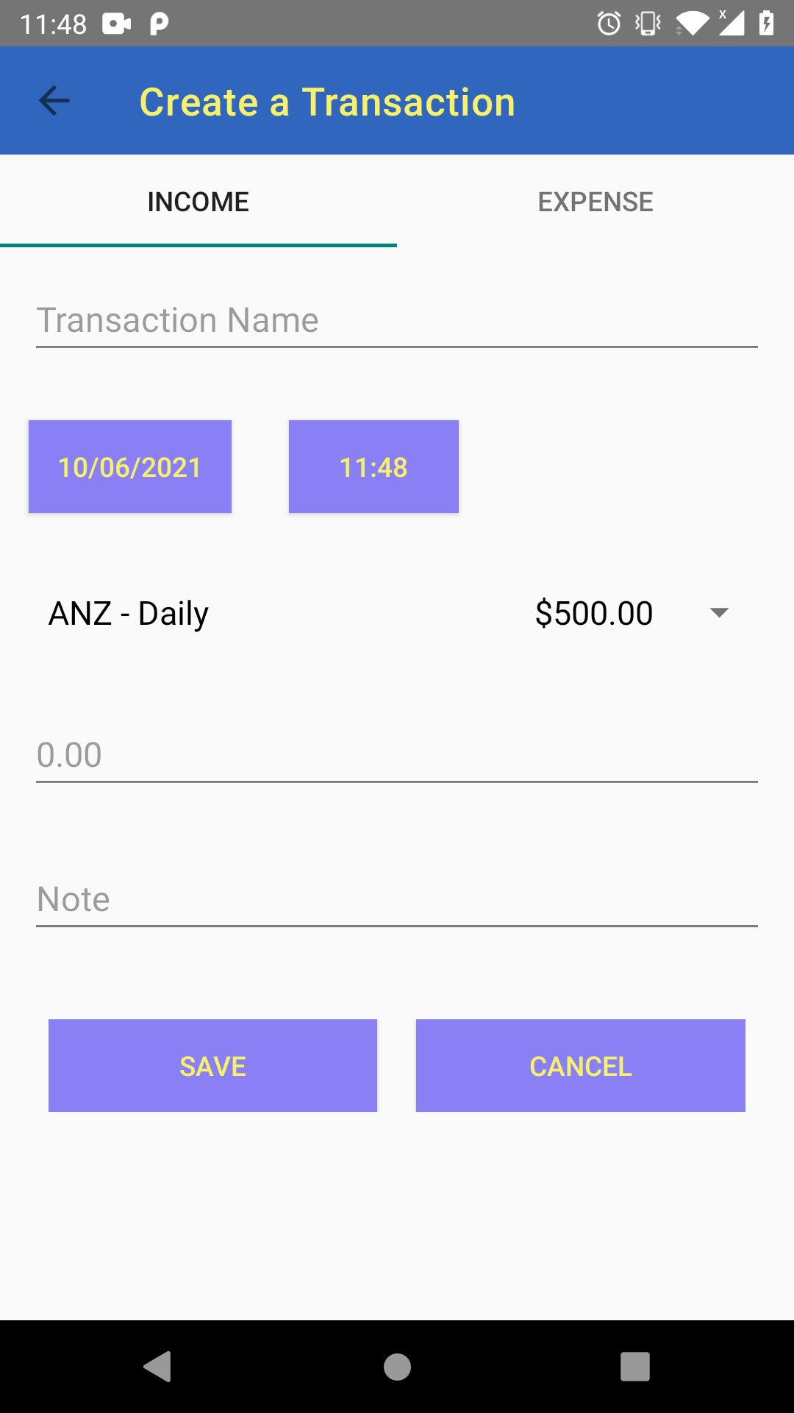
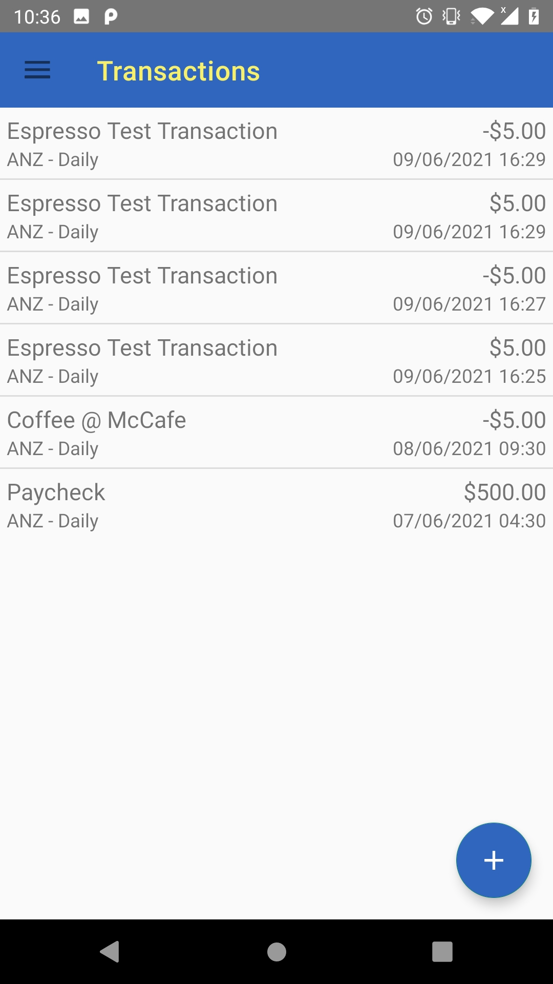
Features
Biometric Login
Navigation Drawer
Floating Action Button
Custom Spinners & List Views
Tabbed Layout, ViewPager & Fragments

Slide 5
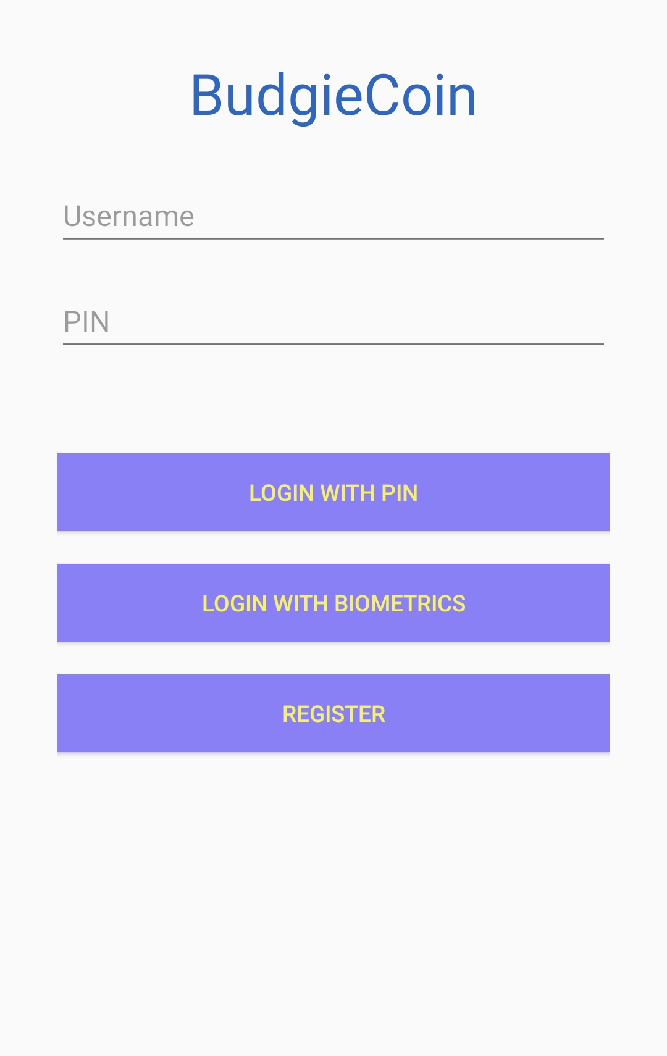
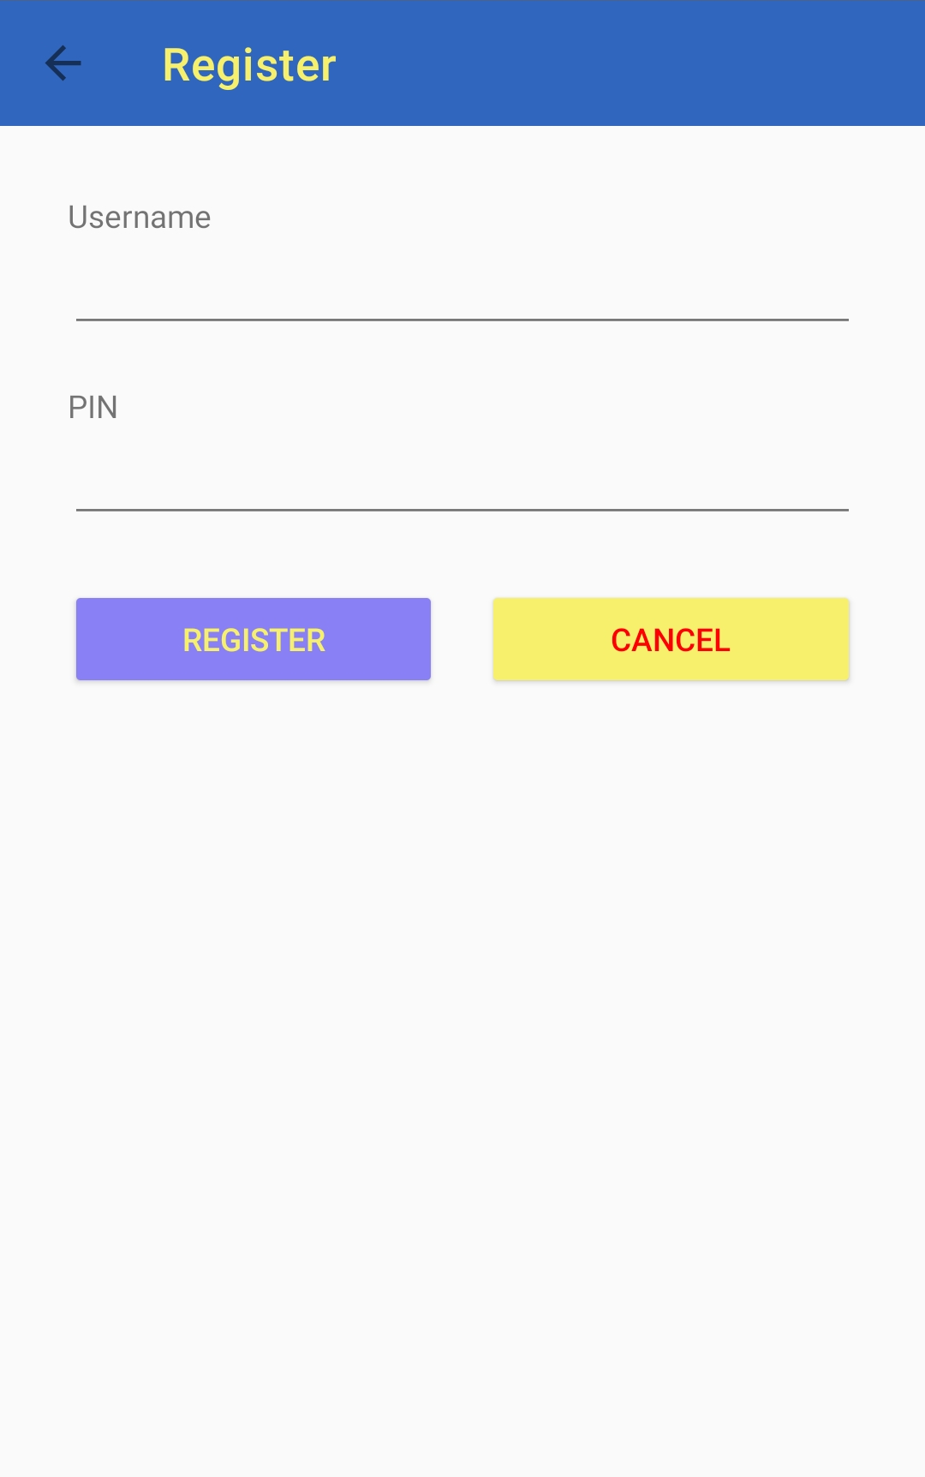
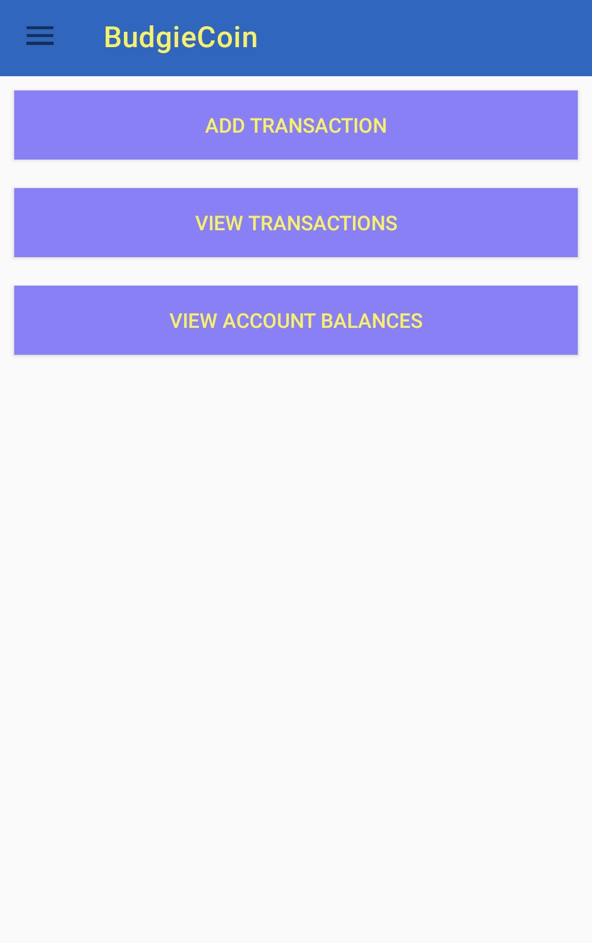
Login, Registration and Main Activities

Slide 6

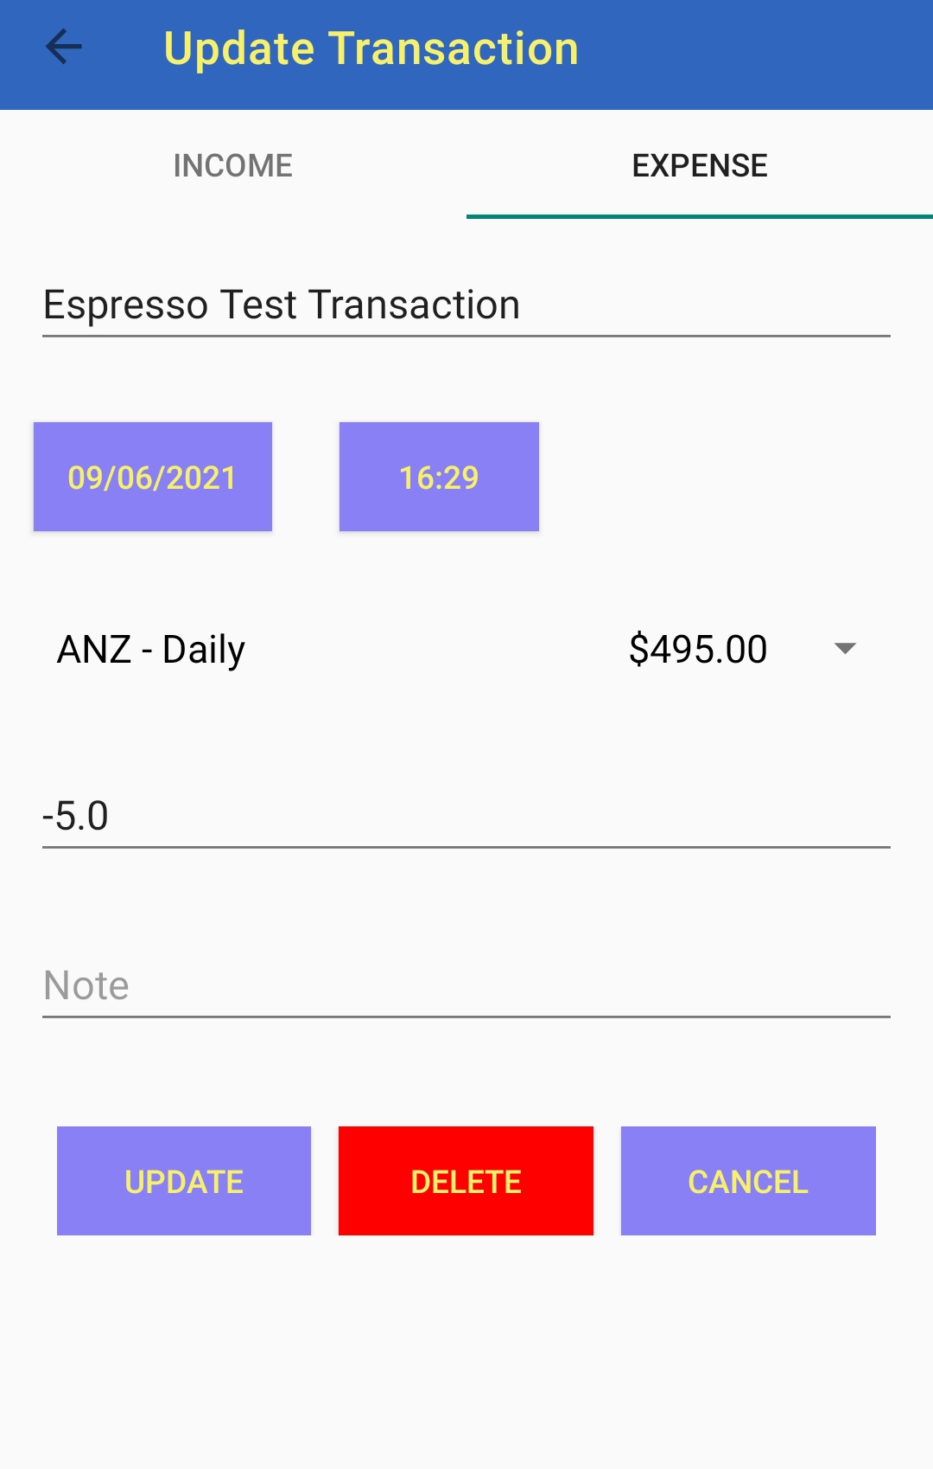
Add and Update transactions

Slide 7
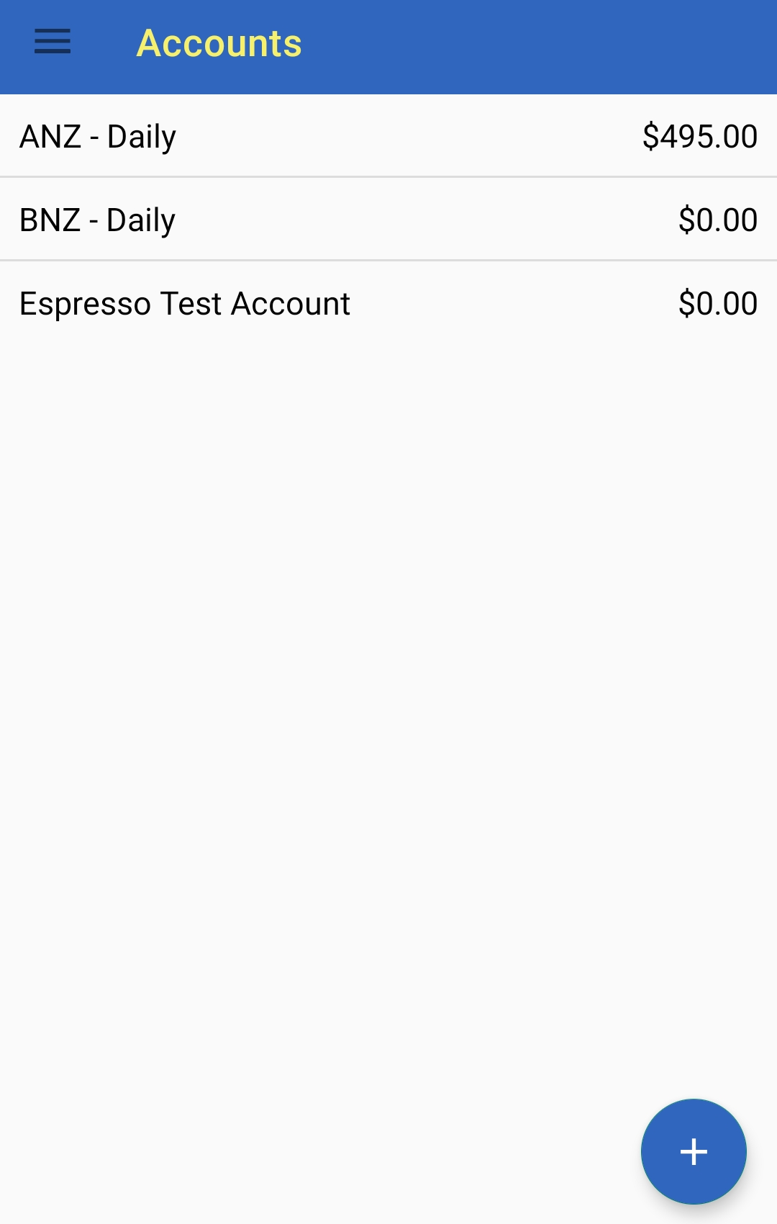
View transactions and account balances

Slide 8
What I learned:
There were a lot of potential features that I could’ve implemented
Some simple things can take longer to implement than expected.
Managing time correctly is important.
Sometimes you just need to make a decision.
Refining existing features vs. Developing new ones.

Slide 9
Thank you!

